Slide 1
GRAY BOX TESTING
What?
Grey box testing is a hybrid of black box and white box testing. It offers the advantage of understanding the front-end, while also understanding some of the internal workings.
Grey box testing provides an excellent way to conduct functional testing at a high level, but it should be combined with more extensive, deeper, white box testing to ensure quality and completion.
Example
Black Box Testing
The tester checks that the HTML is written properly, pointing to the correct URL with the correct syntax.
White Box Testing
The tester clicks the hyperlink and ensures their browser directs them to the expected URL.
Grey Box Testing
The tester clicks the hyperlink, checks that the HTML is coded properly, and verifies their browser directs them to the expected URL.

Slide 2
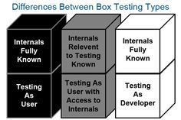




Why?
Provides combined benefits of both black box testing and white box testing both
Combines the input of developers as well as testers and improves overall product quality
Reduces the overhead of long process of testing functional and non-functional types
Gives enough free time for a developer to fix defects
Testing is done from the user point of view rather than a designer point of view
Consultadd BA training_Viji Vijayan
4/4/2019

Slide 3
Types of techniques
Matrix testing
Pattern testing
Orthogonal array testing
Regression testing
Consultadd BA training_Viji Vijayan
4/4/2019

